Slide 1
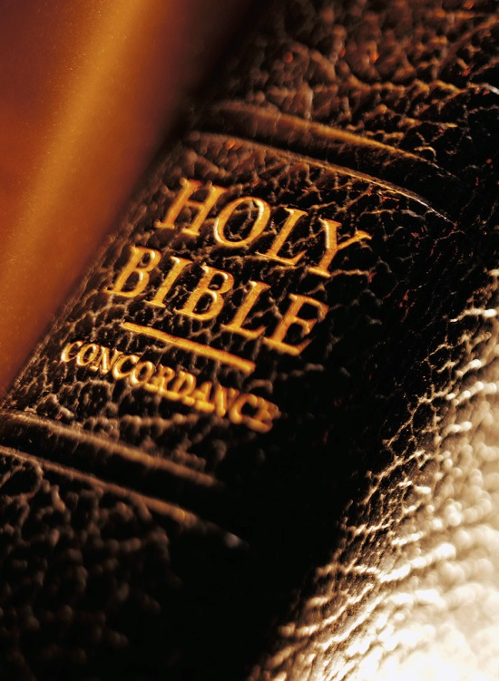
Expository
Excerpts
From Acts 2
(Acts 2:42)
All Verses Are From The NKJV Unless Noted

Slide 2
The Fervor Of The Early Church (1)
Acts 2:42-47

Slide 3
Acts 2 Broken Down
2:1-11 – God Keeps His Promises
2:12, 13 – Man’s Slow Heart
2:14-36 – Wisdom in Answering Critics
2:37-41 – The Desired Effect and Plan
2:42-47 – The Fervor of the Early Church
A. The steadfast practice (2:42)

Slide 4
The Steadfast Practice (2:42)
“And they continued steadfastly in the apostles’ doctrine and fellowship, in the breaking of bread, and in prayers”
(2:41)
WORD
To adhere to, be constant, attentive, devoted, to give unremitting care to, etc.
RECEIVED
BAPTIZED
CONTINUED
people
STEADFASTLY

Slide 5
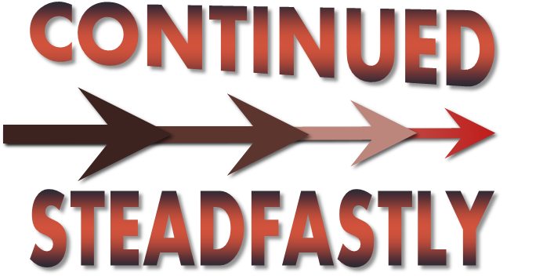
The Steadfast Practice (2:42)
“apostles’ doctrine”
A Desire
An Established Authority

Slide 6
“apostles’ doctrine”
What do we see today?
  A desire to be established in apostolic authority or unity in diversity?
    “not my will be done” or “not Your will but mine be done” (Lk. 22:42)?
    Work within limitations of scripture or broaden where God has narrowed (Lev. 10:1, 2; Eph. 4:4-6; Matt. 19:5, 9; 1 Cor. 16:2; Eph. 5:11; etc.)?
  Fervor or little esteem for “every service” (Heb. 10:25)?

Slide 7
The Steadfast Practice (2:42)
“apostles’ doctrine”
A Desire
An Established Authority
How Steadfast We Are Is Often Seen In Our Attendance Record

Slide 8
The Steadfast Practice (2:42)
“apostles’ doctrine”
“fellowship”
Sharing
Attachment
Separation
Heb. 13:16 | 2 Cor. 6:14 | 1 Cor. 1:9 | 2 Cor. 13:14
1Jn. 1:3, 6, 7 | Rom. 15:26 | Gal. 2:9 | Phil. 1:5

Slide 9
The Steadfast Practice (2:42)
“apostles’ doctrine”
“fellowship”
“the breaking of bread”
“Now on the first day of the week, when the disciples came together to break bread, Paul, ready to depart the next day, spoke to them and continued his message until midnight” (Acts 20:7)

Slide 10
The Steadfast Practice (2:42)
“apostles’ doctrine”
“fellowship”
“the breaking of bread”
“prayers”
“…very strong is a working supplication of a righteous man” (Jas. 5:16, YLT)

Slide 11
Are you A Member Of The First Century Church?
Wears the name of Christ?
Works in the name of Christ?
Speaks in the name of Christ?

